Slide 1
Onboarding/Offboarding Automation

Slide 2
Overview
Automation to create user on/offboarding task in Onboarding>Employee Access in Planner. Automation creates user M365 account (email, teams, groups, properties, etc.), and notifies managers, HR, payroll, etc.
  Take into account Location of employee
  Offboardings can be scheduled in advance (set and forget).
Automation Replaces old forms: [DEPRECATED] Employee Onboarding and Employee Offboarding
New Forms: [PILOT] Employee Onboarding/Offboarding Automation (will share after meeting).
HR will use new forms moving forward

Slide 3
Onboarding automation – what does it do?
Creates user M365 account (email, teams, etc.)
Adds new hire to necessary groups based on Department and Location
  EX: A *REDACTED* new hire will be placed in the *REDACTED* and *REDACTED* groups
  Designed for basic initial access (least privilege)
Notifies manager, IT, HR, Payroll, Training of new hire and details
Creates planner task and assigns necessary individuals
TBD users are provisioned basic access (no groups assigned – usually until training completes).

Slide 4
Onboarding email example
*REDACTED*

Slide 5
Planner card from automation
*REDACTED*

Slide 6
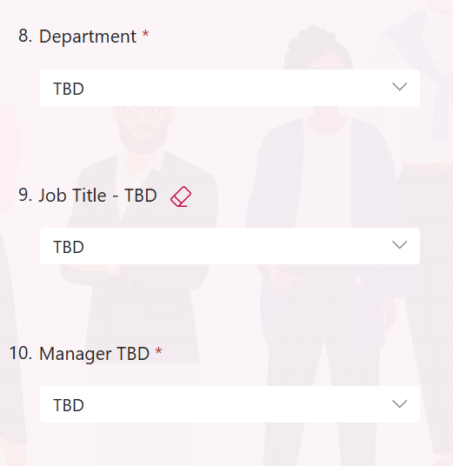
TBD
For new hires who are not assigned a department yet or are going through training.
Basic access
  Email, teams, slack, etc.
  Not granted access to department-specific groups

Slide 7
TBD Email - manager
*REDACTED*

Slide 8
Offboarding Automation – what does it do?
Blocks user sign in, removes group access, notifies relevant parties (once again based on location and department).
Can be scheduled in advance (Scheduled Offboarding in Form)
  EX: An employee is scheduled to be offboarded on 8.15 – has access until the end of the work day (+1 day grace period if *REDACTED* user).
Manager Email and OneDrive access timeline:
  Scheduled – 30 days
  Immediate - 6 months (IT will confirm access with HR after this time via separate automated reminder).

Slide 9
Scheduled offboarding email example
*REDACTED*

Slide 10
Scheduled offboarding email example
*REDACTED*

